Slide 1
System Shopper
Andrew Kingston, Max Dunham, Samuel McRaven

Slide 2
Features
Search through catalog of items
Select items by category
Filter list
System Builder shows compatibility of parts
Shopping Cart
Shipping Information

Slide 3
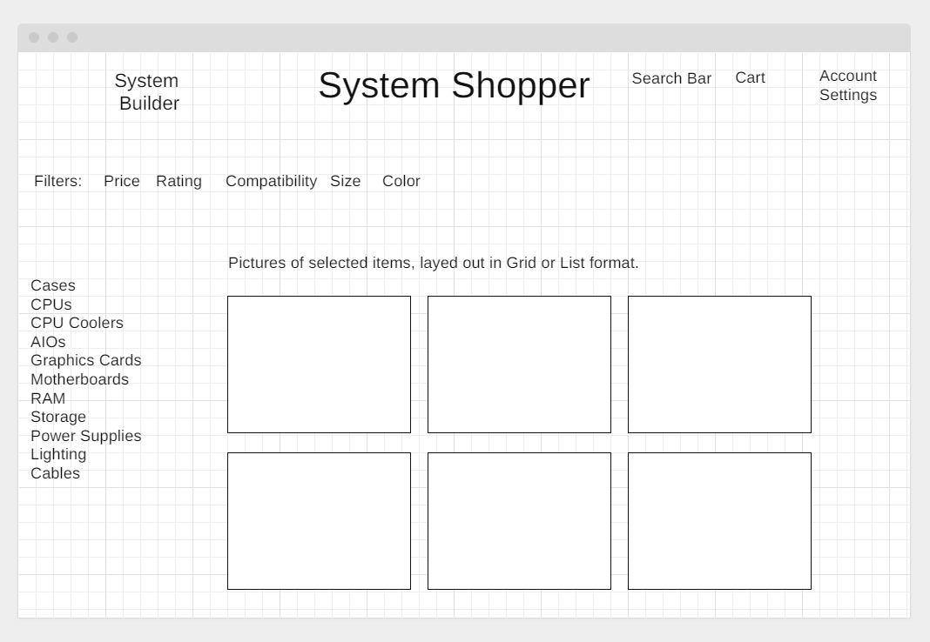
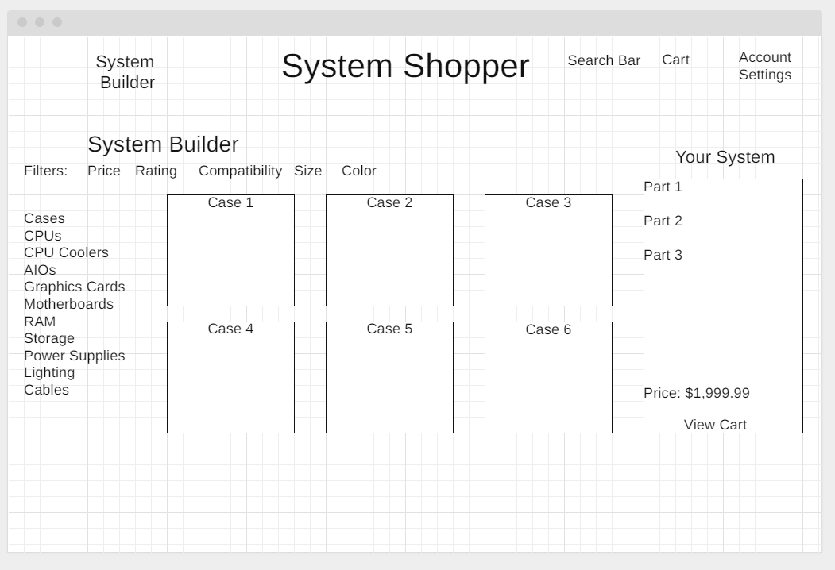
Wireframes
Main Page
System Builder

Slide 4
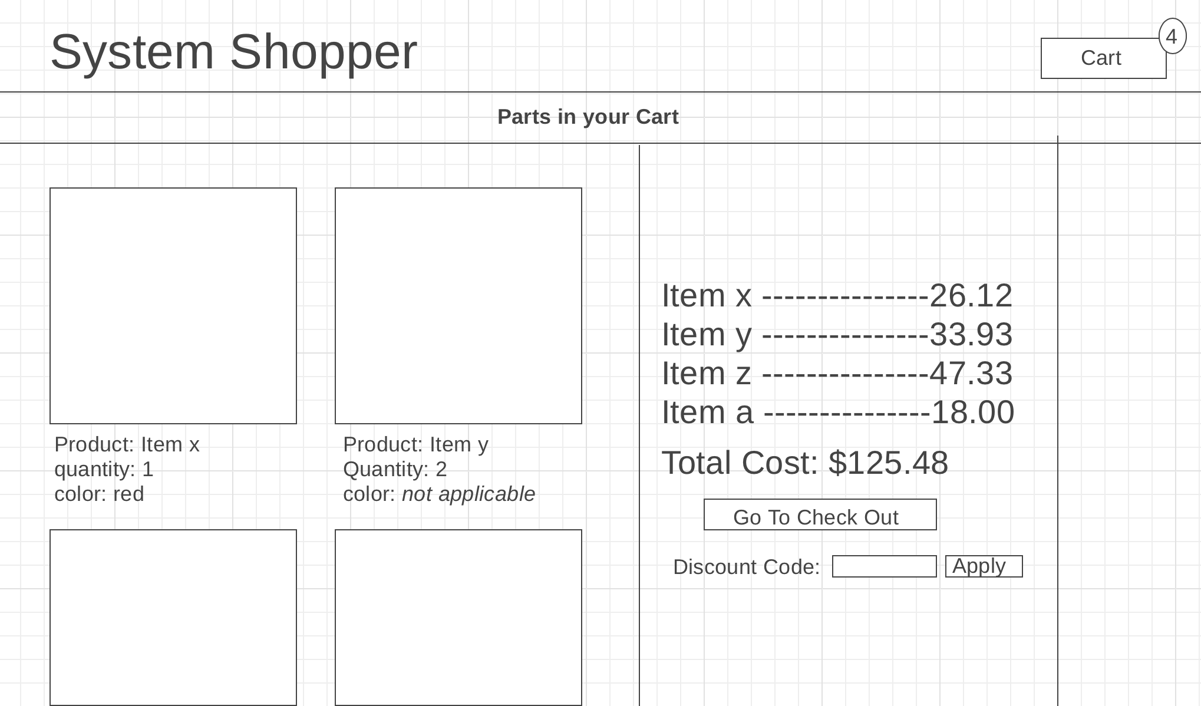
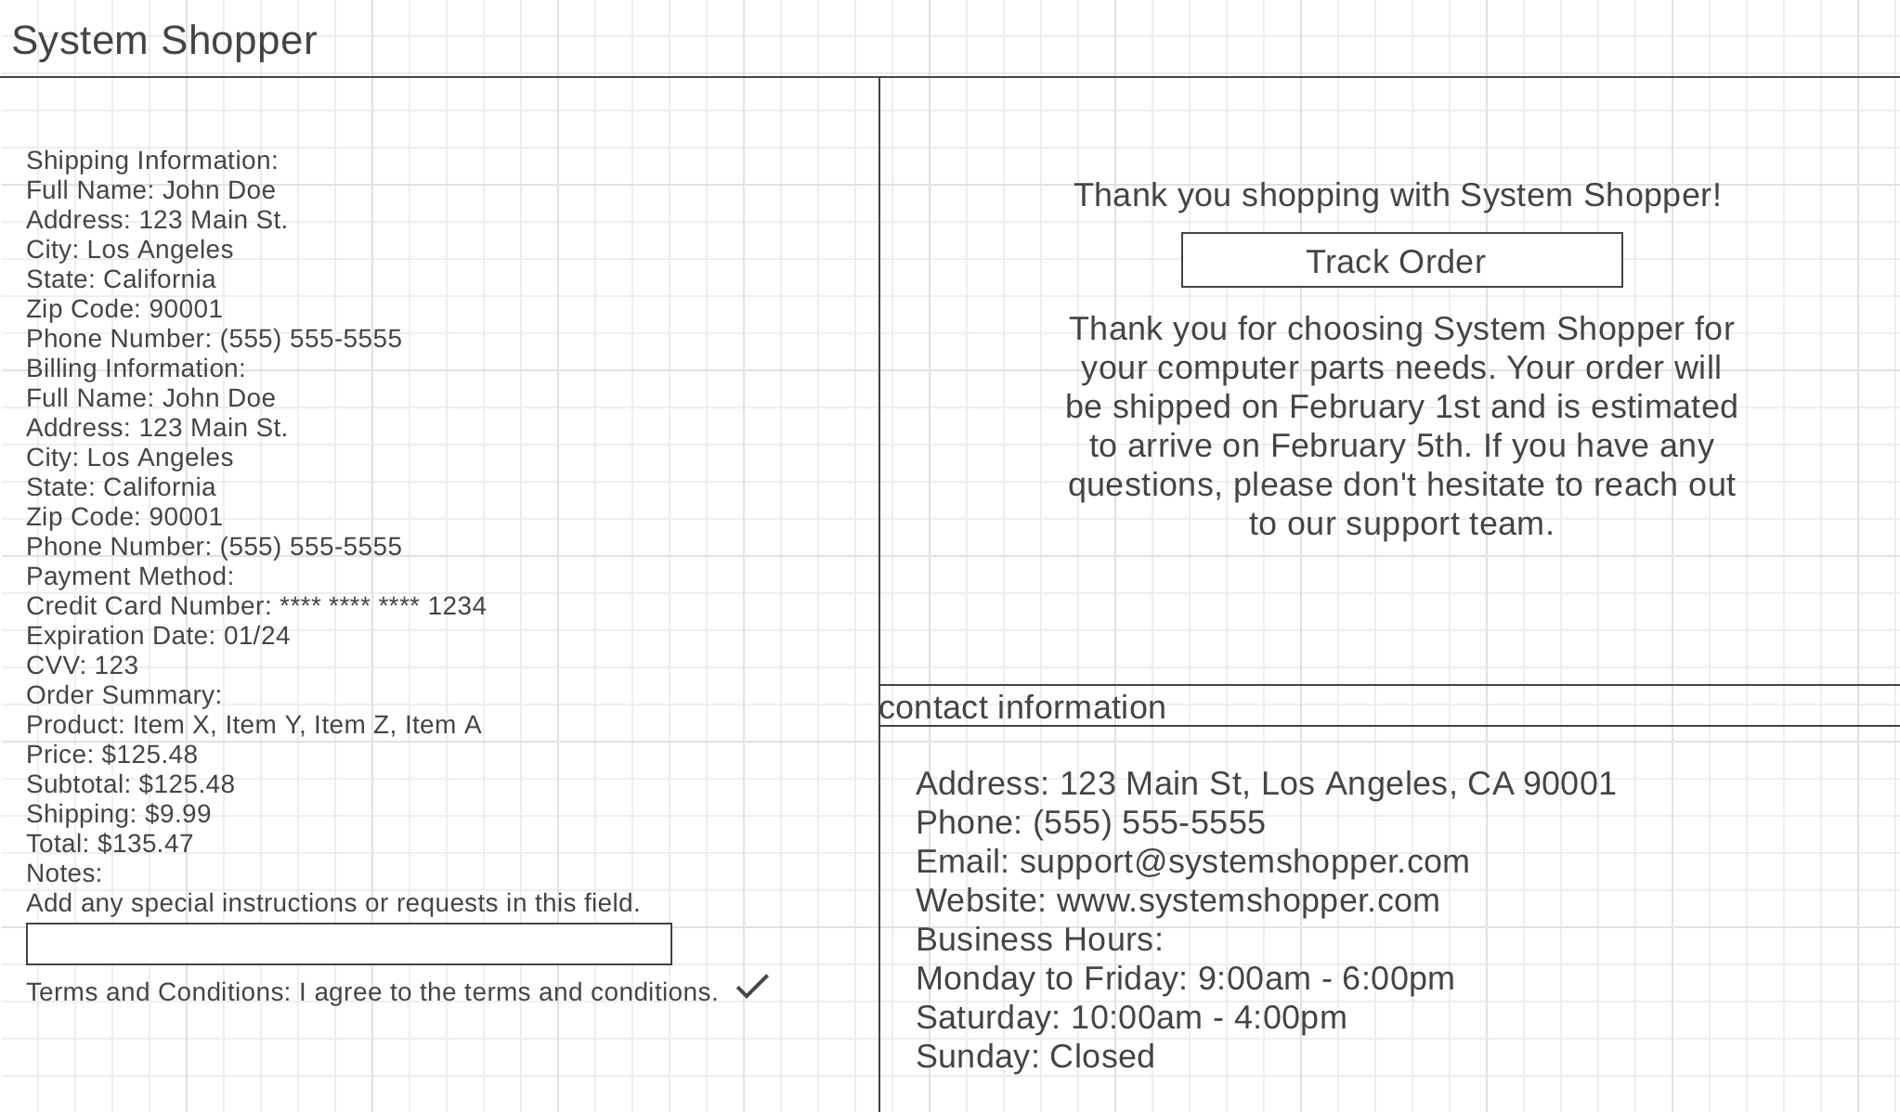
Wireframes
Cart
Shipping Info

Slide 5
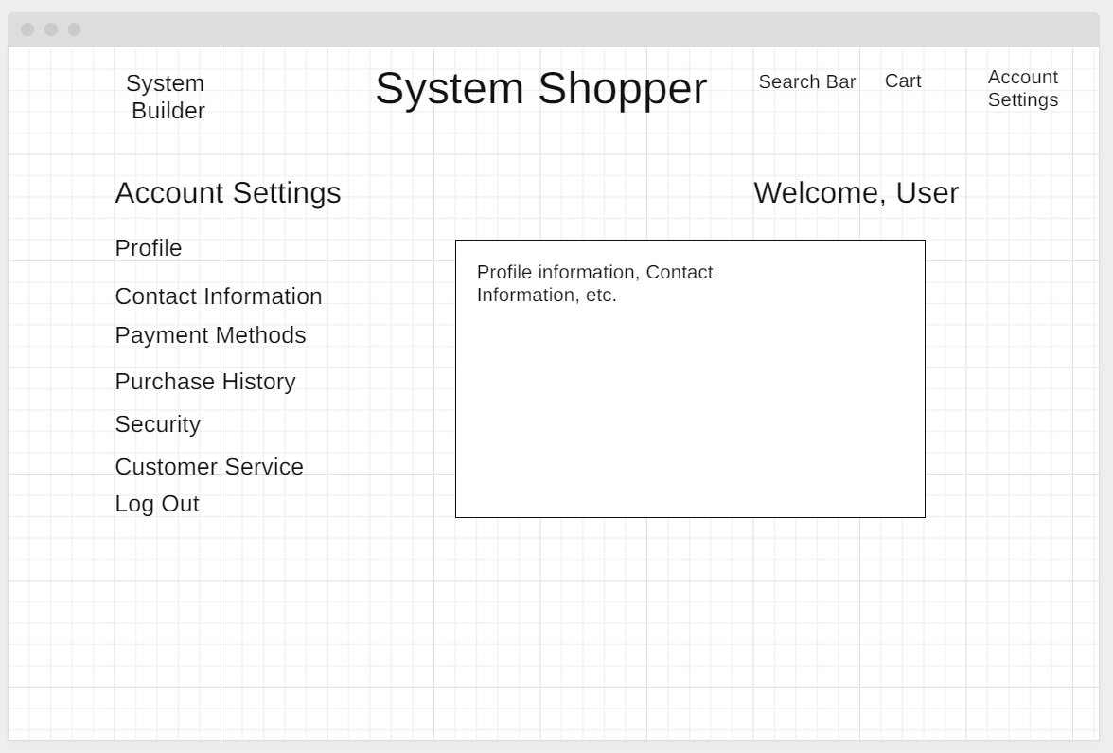
Wireframes
Account Settings

Slide 6
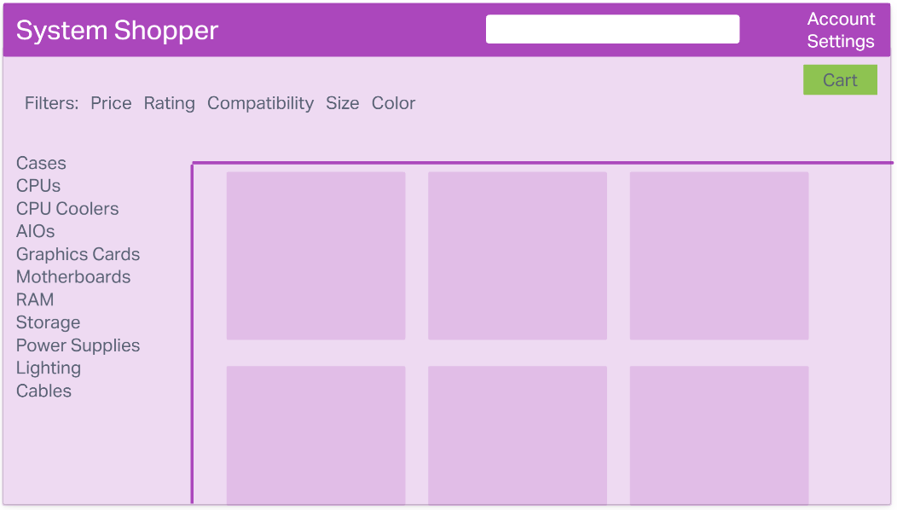
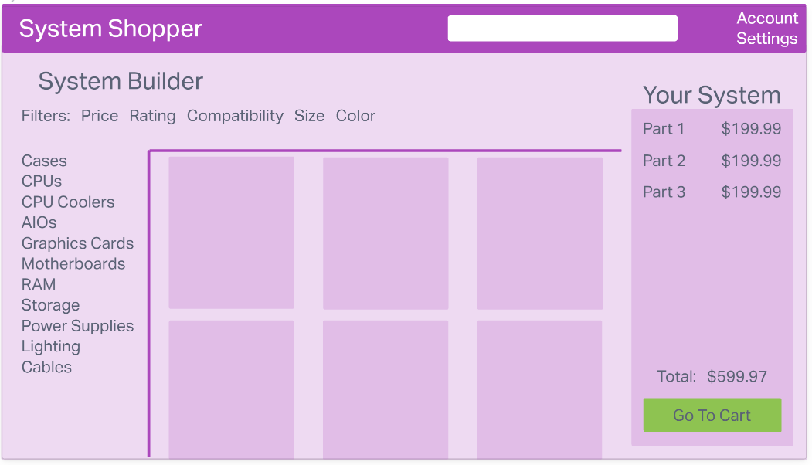
Mockups
Main Page
System Builder

Slide 7
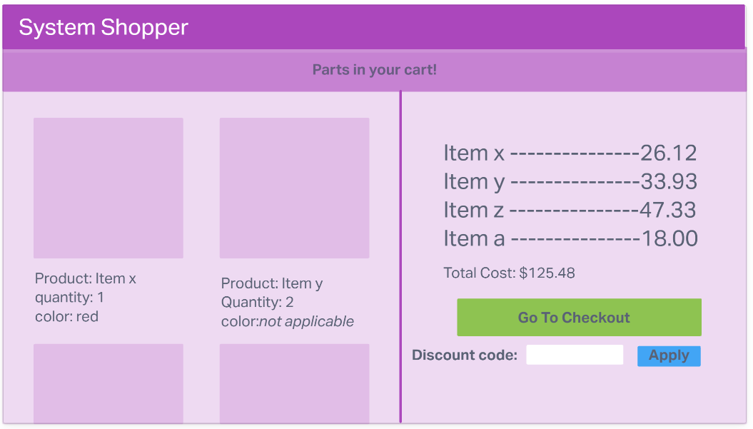
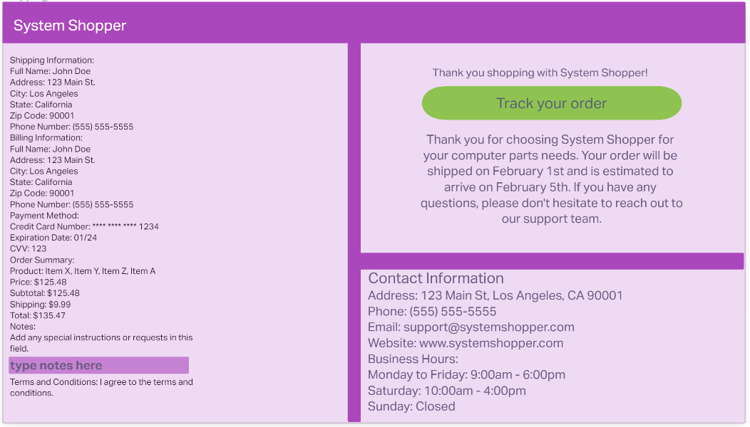
Mockups
Cart
Shipping Info

Slide 8
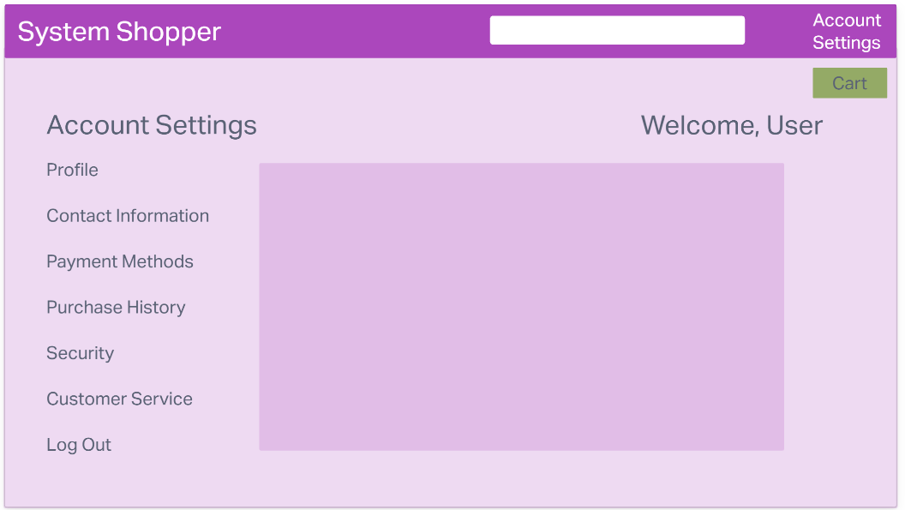
Mockups
Account Settings

